Slide 1
Emission of Light, Light Pressure and Photo-Electric Effect : Concept of Photons
Lecture 35

Slide 2
What is the origin of EM field?
E
Stationary charges
q
Only static electric field
E
Charges moving with constant velocity
j
q
v
B
Static magnetic fields
q
Must be accelerating charges
a

Slide 3
z
Radiation of Accelerating charge
At t=0 the charge q is stationary and its radial Coulomb field is
cτ/n
θ
At t=0 the charge starts accelerating with acceleration a
vt₁sinθ
t=t₁
vt₁
v=aτ
a
At t=τ the charge stops accelerating and reaches a steady velocity
t=τ
t=0
q
ct₁
At t=t₁ the charge is at a new position
c(t₁-τ)/n
Now the radial field is centered at z
The field lines must be continuous
E_{r}
The points within sphere with radius c(t₁-τ)/n “know” that the charge is moving with velocity v
Now there is a tangential component to the field reflecting the short burst of acceleration at 0<t<τ
The points outside sphere with radius ct₁/n still “think” that the charge is stationary at r=0
“slow decay”

Slide 4
Dipole radiation
+
Consider electron oscillating around ion – oscillating dipole
In the far field zone
Retardation – field at time t is determined by the acceleration at time r/c prior to it
Spherical
co-ordinates
Spherical Wave
Magnetic field

Slide 5
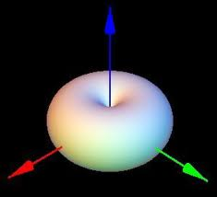
Radiating power
Average Power Density
z
90
1
120
60
0.8
Total radiating power
0.6
150
30
0.4
In 3D
0.2
180
0
210
330
Increases as 4th power of frequency!
In electronics radiation losses increase with frequency – therefore at higher frequencies the wires must be shielded (coaxial cable) .
240
300
270

Slide 6
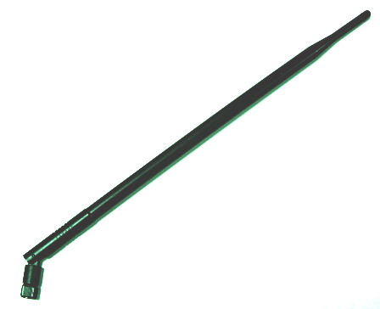

Dipole Antenna

Slide 7
Radiative decay
Consider dipole oscillating at its resonance frequency
Its Kinetic energy is
Its Potential energy is
Total dipole energy is
Express electrical dipole amplitude via its energy
The loss of dipole energy is equal to the power it radiates
Introduce Radiative decay rate

Slide 8
Radiative decay-spectrum
p(t)
p₀(t)
t
2τ_{R}
Emission is radiatively broadened
Fourier Transform
Spectral Power density of radiation

Slide 9
Light pressure
E
v
F_{M}
Area δA completely absorbs the light
Thus all the energy of light is transferred to the moving charges in the medium
δA
k
S
B
Magnetic force acting upon the charge q (electron) in the medium
Power transferred to the electron
Time-averaged force
Energy density
Pressure:
Sunlight near Earth
Laser

Slide 10
Momentum of Light
δA
Light dispersion
E
δp
cδt/n
At normal incidence the force acting on area δA
Electron dispersion
Change of Momentum of area δA
p
Over time interval δt area δA gains momentum
is the volume containing all the light absorbed by dA during time interval dt
That light must have carried momentum δp
Momentum density
Photons: particles with energy E_{ph} U=N_{ph} E_{ph}

Slide 11
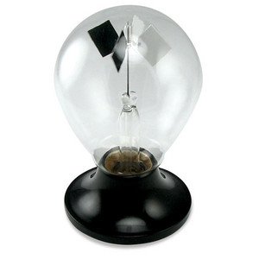
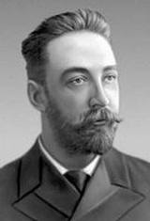
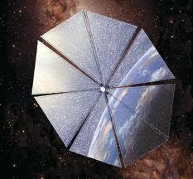
Radiation pressure
Petr Lebedev
1866-1912
Radiometer
+p
torque
Solar sail
+p
+2p
+p
-p
Radiation

Slide 12
Photo Electric Effect
S(ω)
I
S₂>S₁
S₁
V
I
A
+
-V₀
V
eΦ
Blocking Voltage
Blocking Voltage is not a function of light’s power!

Slide 13
S(ω)
Photo Electric Effect
I
ω ₂> ω ₁
V
I
A
+
-V_{0,1}
ω ₁
-V_{0,2}
V
eΦ
Blocking Voltage is a function of light’s frequency!
Linear function!
No current below
The light is quantized!

Slide 14
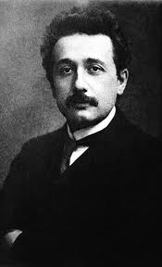
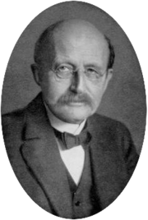
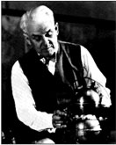
Planck’s Hypothesis - photons
According to Max Planck (1899) Electromagnetic energy can only be emitted only in quantized form, in other words, the energy could only be a multiple of an elementary unit
Einstein (1905) explained Lenard’s experiments and introduced the term “photon” with energy
1879-1955
1858-1947
Robert Millican did not believe Einstein and did experiments to disprove it but ended up proving it and measuring Planck’s constant
1868-1953

Slide 15
Photons – Energy and Momentum
Light dispersion
Does it make sense?
Let us look at the diffraction experiment from the wave point of view
And from the particle point of view….
The larger is the k the more difficult it is to change the direction of propagation
The larger is the p the more difficult it is to change the propagation direction

Slide 16
Concept of photons
Previously we have shown that the (averaged) energy density of EM field is
and the power flow density is
What if we assume that the energy is carried by the particles called photons whose energy is and whose density is ?
Then and
But in general not every “mode” of frequency ω and wavevector k=n ω/c is allowed by boundary conditions. Consider a simple case of a standing wave in a resonator made up by 2 metal mirrors placed at distance L from each other
L
Boundary conditions
and
Δ ω
Δ ω
Δ ω
Δ ω
Modes are separated by
ω
2 polarizations
The density of modes per unit (angular) frequency interval is
The density of modes per unit (angular) frequency interval per unit length is

Slide 17
Photons in 3D space
k_{y}
Modes of EM field
Metal cube L³
Boundary conditions
k_{x}
Dispersion relation
Each mode occupies this volume in k-space:
k_{z}
The number of modes whose wave vector is less than some k

Slide 18
Density of photon states
The number of modes per unit volume whose
frequency is less than ω=ck/n
The density of photon states
Each allowed more can be occupied by quanta of EM field –photons with energy
ρ( ω)
Using frequency ν
ω
Each box (λ/n)³ contains a few modes…

Slide 19
Planck’s Formula
E₂
According to thermodynamics the probabilities of a system in thermal being in states 1 and 2 relate as
State n – a state with n photons in a given mode
E₁
Average number of photons in each mode @ T
E_{n+1}
E_{n}
Bose Einstein Distribution
E₂
The energy density of radiation
E₁
Planck’s Formula
E₀

Slide 20
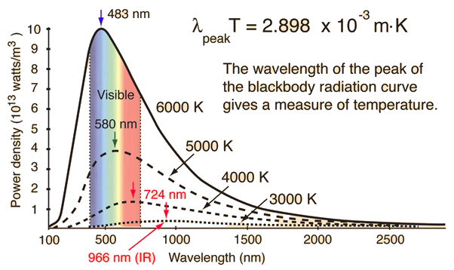
Black Body Radiation
Assume that we have a “black body” (i.e. no reflections) in thermal equilibrium with the photons around it (sun is a “black body”)
If we go from frequency to wavelength
The spectral brightness of “black body” – power emitted into a unit solid angle

Slide 21
Extreme cases of Bose Einstein Statistics
_{A}
Electronics, RF
Classical result (Plank’s constant h is absent)
Performance of electronic devices is always limited by the thermal noise
_{B}
Photonics (visible, near IR)
Boltzmann distribution
Performance of photonic devices up to near-IR is Shot noise limited
_{C}
From sub-mm waves to mid-IR
Things get complicated

Slide 22
Einstein’s coefficients
Consider a quantum system of N “atoms” with two states of energies E₁ and E₂>E₁ that is in thermal equilibrium with photons permeating it. The question is: ”How does it settle into equilibrium?”
E₂
N₂
g₂
Introduce spectral energy density
B₁₂U_{ω} N₁
B₂₁U_{ω} N₂
A₂₁N₂
Balance equation:
absorption
stimulated emission
E₁
N₁
g₁
g_{i} –degeneracy (number of states with the same energy)
spontaneous emission
(A₂₁ -1st Einstein Coefficient)
B₁₂ –second Einstein’s coefficient ( )
At equilibrium d/dt=0
The only way this equilibrium can be maintained is if

Slide 23
Absorption coefficient
Let us introduce broadening of the transition as
For example, Lorentzian broadening
Balance equation becomes
=1
If we have a monochromatic (relative to transition broadening) wave
is energy density (J/cm³)
ω
Power density
ω
ω₂₁
ω₂₁
ω₀
If N₂=0, N₁=N
Absorption coefficient
The energy is being transferred to atom from the field
(continuity equation)

Slide 24
Absorption coefficient
Compare it with classical absorption coefficient

Slide 25
Quantum mechanical origin of the Einstein Coefficients
E₂
Consider the two-level system with energies E₁ and E₂
and the incoming AC field
According to the Fermi Golden Rule the probability of the transition between two (nondegenerate) states 1 and 2 in the presence of AC electric field is
E₁
The term H₁₂ is the Interaction Hamiltonian between the matter (atom) and the electric field
The term er₁₂ is the matrix element of the dipole moment, which is different from the classical dipole moment and can be found as
where we have introduced the wave functions Ψ₁ and Ψ₂ . Note that the states with the same parity have p₁₂=0 – forbidden transition, while for opposite parities the transition is allowed.
Note that both upward (absorption by the unexcited atom ) and downward (stimulated emission by the excited atom) processes have equal probability, because the field has both –jωt and + jωt terms.
If the transition is broadened than one can say that the transition energy is not well defined but is spread out according to broadening function g(ω).
Polarization direction

Slide 26
Oscillator strength
E₂
where the energy density is
E₁
Assume that the field is x-polarized
Compare this with the Einstein’s equations
To make them equal, multiply classical rate by a corrective factor, called oscillator strength
We obtain
At the same time, from classical consideration….

Slide 27
Oscillator strength and susceptibility
The oscillator strength is
Oscillator sum rule
Note that formally f₂₁ = -f₁₂
Using relations between absorption coefficient and susceptibility, it is not difficult to obtain the expression for susceptibility
Maximum value of oscillator strength for fully allowed transition is 1.
But remember that for each atom its dipole r₁₂ is directed along a certain direction, so, in general case we need to perform averaging and

Slide 28
Quantum susceptibility
E_{n}
N_{n}
f_{mn}
E_{m+1}
N_{m+1}
f_{m,m+1}
E_{m}
N_{m}
α
f_{2m}
f_{2,m+1}
E₂
N₂
f₁₂
f_{1m}
E₁
N₁
ω

Slide 29
Spontaneous Emission
Introduce the spontaneous lifetime
(quantum) spontaneous decay rate
Factor 1/3 takes into account averaging over the angle between dipole and electric field
Classical radiative decay
It appears that….
Classical radiative rate is an upper bound of spontaneous decay rate and for strong allowed transitions spontaneous rate approaches its classical limit

